Slide 1


Transform Tools with Applications
Decimation & Interpolation
carmine.clemente@strath.ac.uk

Slide 2
Decimation & Interpolation
Interpolation increases the sampling frequency;
Decimation Decreases the sampling frequency;
These are important tools when dealing with multi-rate systems (i.e. system working at different sampling frequencies).
Or if you have some prior knowledge about the bandwidth of your signal then you can use decimation to reduce the processing/memory requirements.

Slide 3


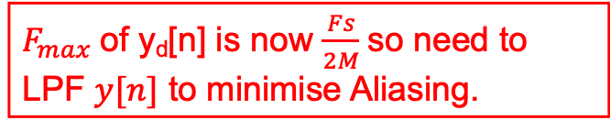
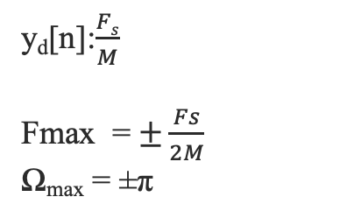
Decimation by a factor M
Takes every M samples
y_{d}[n]: $\frac{Fs}{M}$
y[n]: Fs
M:1
$F_{max}⁡$of y_{d}[n] is now $\frac{Fs}{2M}$so need to LPF $y[n]$ to minimise Aliasing.
Acts as anti-aliasing filter
y[n]:F_{s}
LPF , Gain 1
$Ω$_{c}=π/M
w[n]:F_{s}
y_{d}[n]:$\frac{Fs}{M}$
Fmax = $±\frac{Fs}{2M}$
Ω_{max} = ±π
M:1
Fmax = ±Fs/2
Ω_{max} = ±π
So a decimation process requires 2 stages - 1) LPF – 2) the actual decimation
Matlab functions : ‘decimate’ and ‘resample’

Slide 4

Decimation by a factor M in the Z-domain
The z-transform of a decimated sequence $xd[n]$. Consider the example
$x[n]= [ …7 3 5 2 9 6 4 …]$and $M=2$
$xd[n]= x[2n] = [ …7 5 9 4 …]$
Taking the Z-transform produces
$$X\left(z\right)=…+7 z2 + 3 z + 5 + 2z^{−1} + 9 z^{−2} +6z^{−3} + 4z^{−4} +…$$
$$X_{d}\left(z\right)=… + 7z + 5 + 9z^{−1}+4z^{−2} +…$$

Slide 5
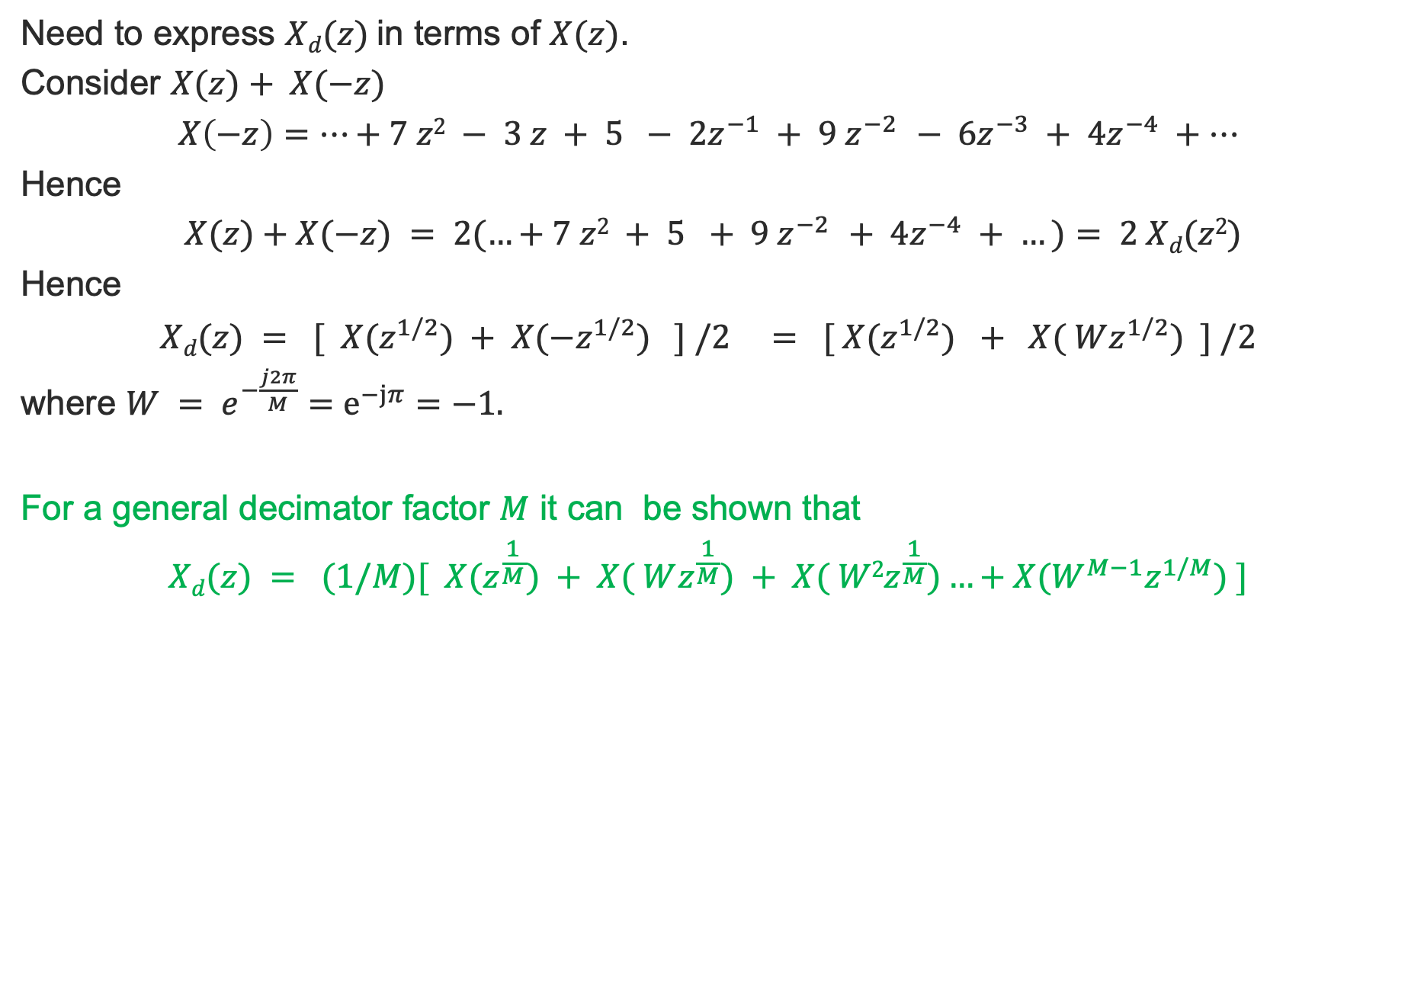
Decimation by a factor M in the Z-domain
Need to express $Xd(z)$in terms of $X(z)$.
Consider $X(z)+ X(−z)$
$$X\left(−z\right)=…+7 z2 − 3 z + 5 − 2z^{−1} + 9 z^{−2} − 6z^{−3} + 4z^{−4} +…$$
Hence
$X(z)+X(−z) = 2(…+7 z2 + 5 + 9 z^{−2} + 4z^{−4} + …)= 2 Xd(z2)$
Hence
$$Xd(z) = [ X(z^{1/2}) + X(−z^{1/2}) ] /2 = [ X(z^{1/2}) + X( Wz^{1/2}) ] /2$$
where $W = e^{−\frac{j2π}{M}}=e^{−jπ}=−1.$
For a general decimator factor $M$ it can be shown that
$$Xd(z) = (1/M)[ X(z^{\frac{1}{M}}) + X( Wz^{\frac{1}{M}}) + X( W2z^{\frac{1}{M}})…+X(W^{M−1}z^{1/M}) ]$$

Slide 6
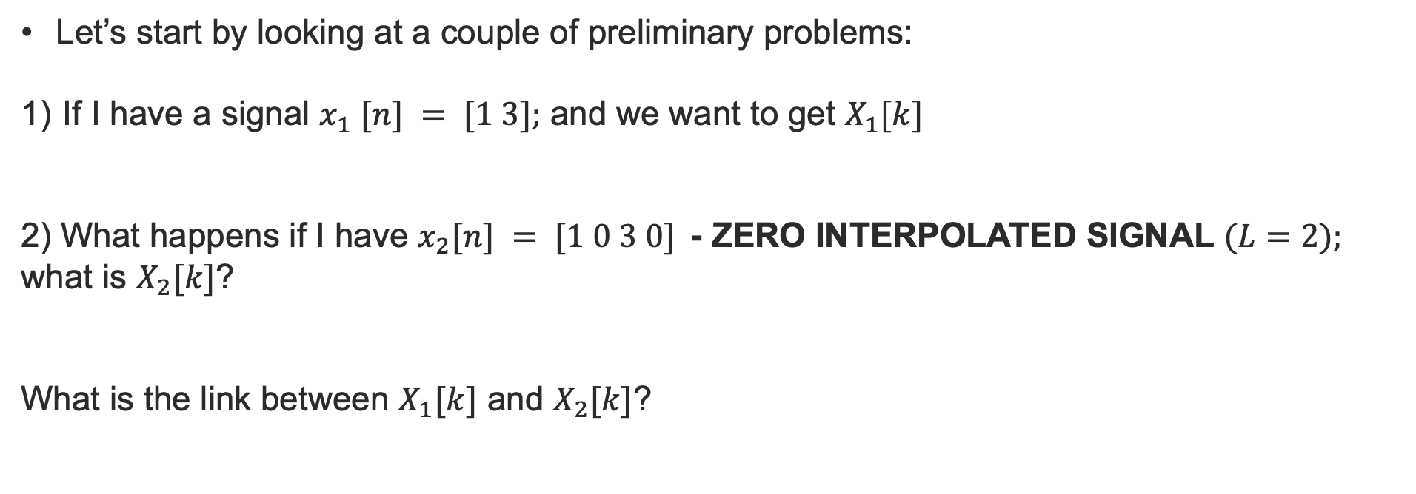
Zero Interpolation
Let’s start by looking at a couple of preliminary problems:
If I have a signal $x_{1} [n] = [1 3];$ and we want to get $X_{1}[k]$
2) What happens if I have $x_{2}[n] = [1 0 3 0]$- ZERO INTERPOLATED SIGNAL $(L=2);$
what is $X_{2}[k]$?
What is the link between $X_{1}[k]$ and $X_{2}[k]$?

Slide 7



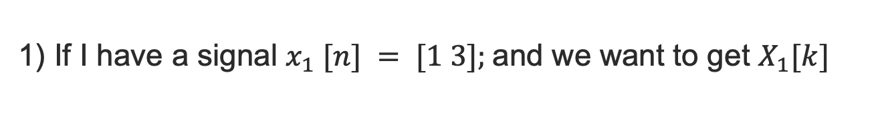


Zero Interpolation
1) If I have a signal $x_{1} [n] = [1 3];$and we want to get $X_{1}[k]$
1
+
$$4$$
$$x_{1}[n]$$
$$X_{1}[k] = [4 −2]$$
3
+
$$−2$$
$$W_{2}^{0}$$
-

Slide 8



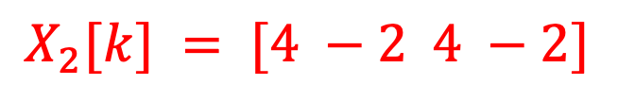
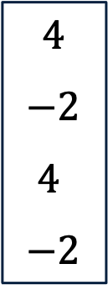
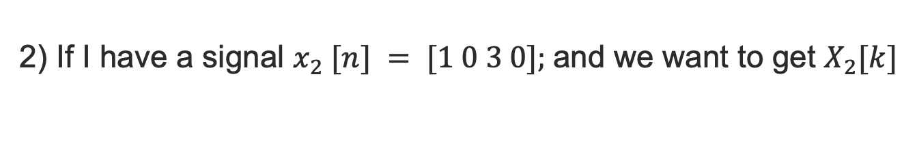






Zero Interpolation
2) If I have a signal $x_{2} [n] = [1 0 3 0];$and we want to get $X_{2}[k]$
$$x_{2}[n]$$
1
0
3
0
1
3
0
0
1
3
0
0
+
$$4$$
+
$$4$$
$$−2$$
$$4$$
$$−2$$
-
$$−2$$
+
$$W_{2}^{0}$$
+
+
$$0$$
$$W_{4}^{0}$$
-
+
-
$$0$$
$$W_{2}^{0}$$
+
-
+
$$W_{4}^{1}$$
$$X_{2}[k] = [4 −2 4 −2]$$
So for L=2, the spectrum of $x_{1}[n]$ is repeated

Slide 9

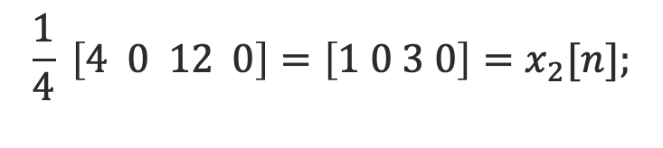
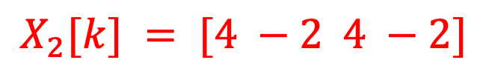


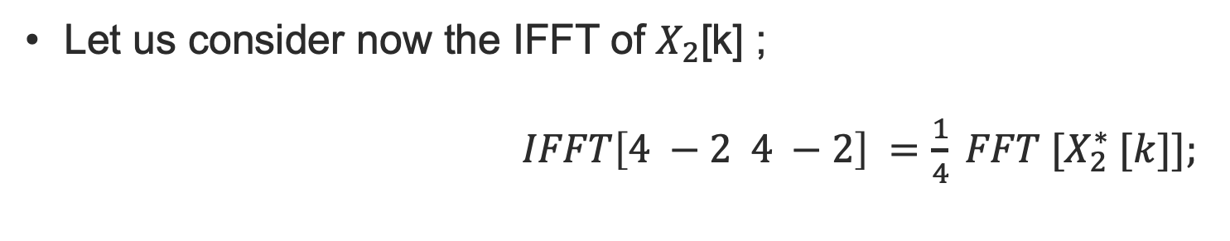



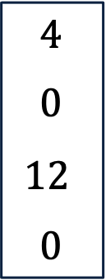


Zero Interpolation
$$X_{2}[k] = [4 −2 4 −2]$$
Let us consider now the IFFT of $X_{2}$[k] ;
$IFFT\left[4 −2 4 −2\right] =\frac{1}{4} FFT [X_{2}^{∗} [k]];$
4
-2
4
-2
4
4
-2
-2
4
4
-2
-2
+
$$8$$
+
$$4$$
$$0$$
$$12$$
$$0$$
-
$$0$$
+
$$W_{2}^{0}$$
+
+
$$−4$$
-
+
$$W_{4}^{0}$$
-
$$0$$
$$W_{2}^{0}$$
+
-
+
$$W_{4}^{1}$$
$$\frac{1}{4} \left[4 0 12 0\right]=\left[1 0 3 0\right]=x_{2}[n];$$

Slide 10
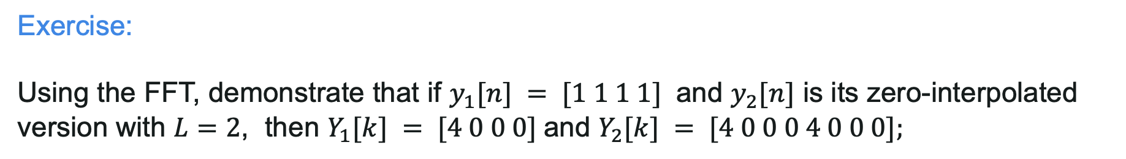
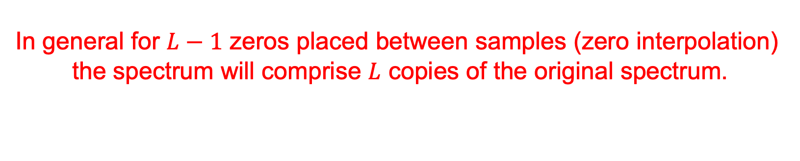
Zero Interpolation
In general for $L−1$ zeros placed between samples (zero interpolation)
the spectrum will comprise $L$ copies of the original spectrum.
Exercise:
Using the FFT, demonstrate that if $y_{1}[n] = [1 1 1 1]$ and $y_{2}[n]$ is its zero-interpolated version with $L=2$, then $Y_{1}[k] = [4 0 0 0]$and $Y_{2}[k] = [4 0 0 0 4 0 0 0];$

Slide 11



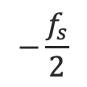
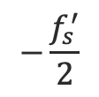

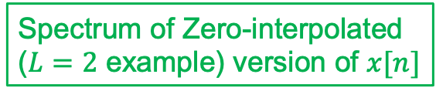
Interpolation by a factor L
Remember that the spectrum is periodic and as we have seen, when interpolating with zeros we get a replication of the spectrum.
Assume $L=2$and therefore $f_{s}^{′}=2f_{s}$then a zero interpolated signal will place $(L−1)$zeros between samples with a resulting spectrum that comprises exactly two periods of the original spectrum.
$$X(f) or X(Ω)$$
$$−\frac{f_{s}}{2}$$
$$\frac{f_{s}}{2}$$
Spectral images that need to be removed using a LPF
Spectrum of Zero-interpolated ($L=2$ example) version of $x[n]$
$$Y(f) or Y(Ω)$$
$$−\frac{f_{s}^{′}}{2}$$
$$\frac{f_{s}′}{2}$$
2 periods of the original spectrum

Slide 12

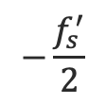


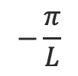



Interpolation by a factor L
To eliminate the spectral images we use a digital filter (note that in DAC we were using an analog filter) with cut-off $±\frac{π}{L}$to remove the spectral images.
$$H(f) or H(Ω)$$
$$L$$
$−π$
$$−\frac{π}{L}$$
$$\frac{π}{L}$$
$π$
That multiplied by Y(f) produces
$$−\frac{f_{s}^{′}}{2}$$
$$\frac{f_{s}′}{2}$$

Slide 13


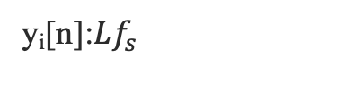
Interpolation by a factor L
y[n]
y_{i}[n]
1:L
Zero Interpolation: Places L-1 Zeros between samples
y[n]:f_{s}
w[n]:L$f_{s}$
y_{i}[n]:$Lf_{s}$
1:L
LPF , Gain L
$Ω$_{c}=π/L
Matlab functions : ‘interp’ and ‘resample’

Slide 14
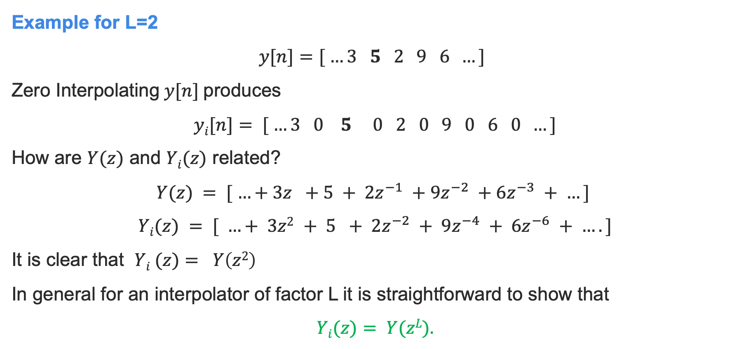
Interpolation by a factor L – in the Z-domain
Example for L=2
$y[n]=[ …3 5 2 9 6 …]$
Zero Interpolating$y[n]$produces
$$yi[n]= [ …3 0 5 0 2 0 9 0 6 0 …]$$
How are $Y(z)$ and $Yi(z)$ related?
$$Y(z) = [ …+3z +5 + 2z^{−1} +9z^{−2} +6z^{−3} + …]$$
$$Yi(z) = [ …+ 3z2 + 5 + 2z^{−2} + 9z^{−4} + 6z^{−6} + ….]$$
It is clear that $Yi (z)= Y\left(z2\right)$
In general for an interpolator of factor L it is straightforward to show that
$$Yi(z)= Y(zL).$$

Slide 15
Interpolation by a factor L
Remarks
No information is lost when a signal is up-sampled.
2. The up-sampler is linear but not a time-invariant system.
3. The up-sampler introduces spectral images that need to be removed.

Slide 16



General Multi-rate – Changing the sampling rate by a factor M/L
y[n]:F_{s}
w[n]:LF_{s}
y_{i}[n]
z[n]:F_{s}
y_{d}[n]
LPF, Gain L
$Ω$_{c}=π/L
LPF , Gain 1
$Ω$_{c}=π/M
M:1
1:L
LPF, Gain L
$Ω_{c}$=min{π/L, π/M}
z[n]:F_{s}
y_{d}[n]
y[n]:F_{s}
w[n]:LF_{s}
M:1
1:L
Matlab function: ‘resample’

Slide 17
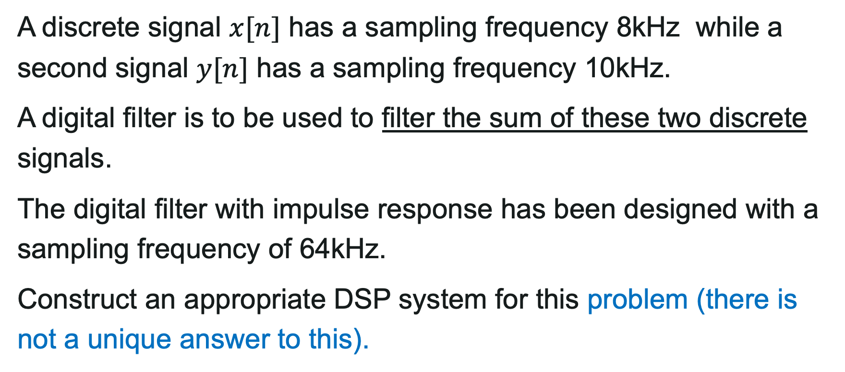
Exercise
A discrete signal $x[n]$ has a sampling frequency 8kHz while a second signal $y[n]$ has a sampling frequency 10kHz.
A digital filter is to be used to filter the sum of these two discrete signals.
The digital filter with impulse response has been designed with a sampling frequency of 64kHz.
Construct an appropriate DSP system for this problem (there is not a unique answer to this).

Slide 18
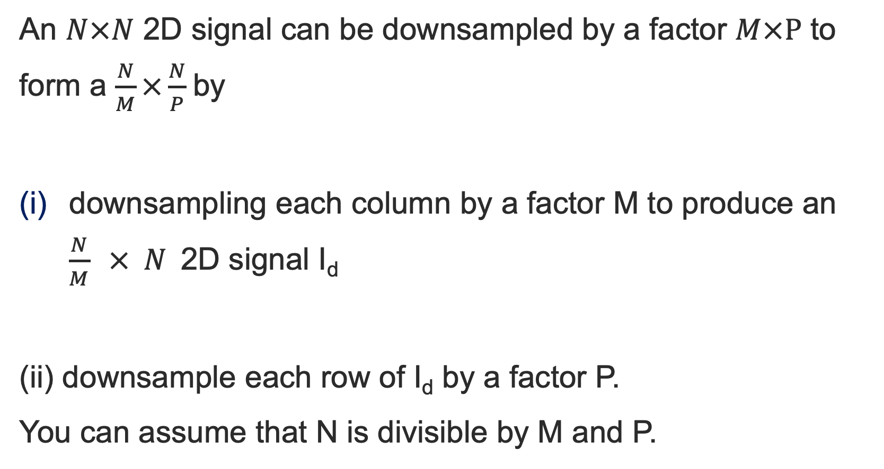
2D Decimation & Interpolation
An $N×N$ 2D signal can be downsampled by a factor $M×P$ to form a $\frac{N}{M}×\frac{N}{P}$by
downsampling each column by a factor M to produce an $\frac{N}{M} × N$2D signal I_{d}
(ii) downsample each row of I_{d} by a factor P.
You can assume that N is divisible by M and P.

Slide 19
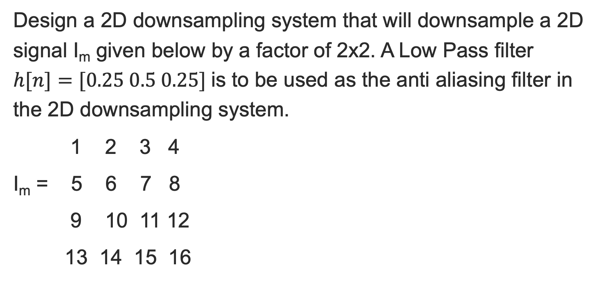
Exercise
Design a 2D downsampling system that will downsample a 2D signal I_{m} given below by a factor of 2x2. A Low Pass filter $h[n]=[0.25 0.5 0.25]$is to be used as the anti aliasing filter in the 2D downsampling system.
1 2 3 4
I_{m} = 5 6 7 8
9 10 11 12
13 14 15 16

